Slide 1
An Introduction to OPNFV
Please direct any questions to info@opnfv.org or lfn-info@linuxfoundation.org

Slide 2
We are an industry in transformation

Slide 3
We Need To Work Together

Slide 4
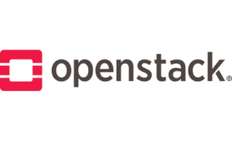
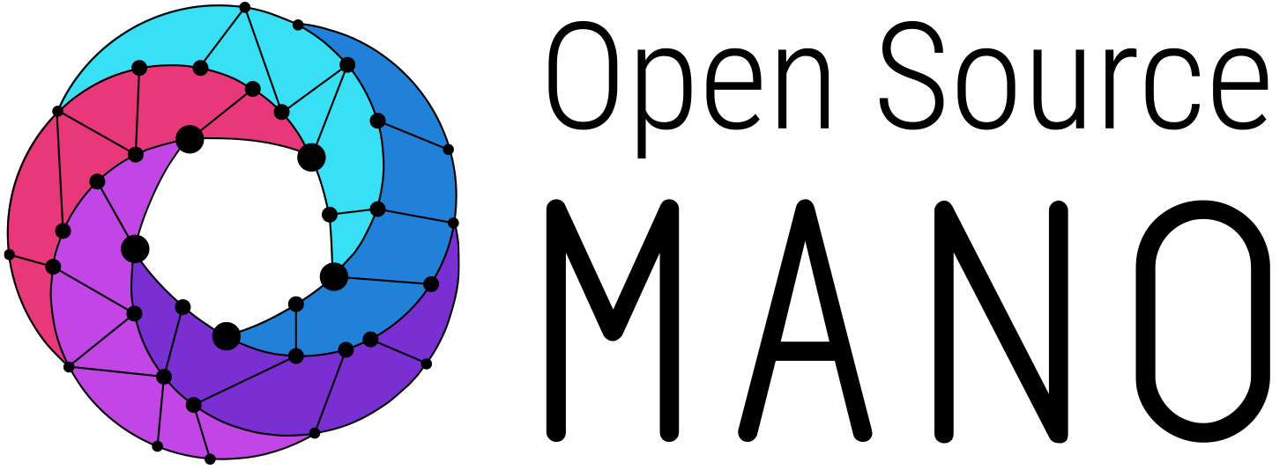
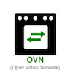
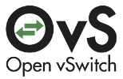
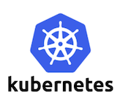

Slide 5
Open Platform for NFV (OPNFV) is a project and community that facilitates a common NFVI, continuous integration (CI) with upstream projects, stand-alone testing toolsets, and a compliance and verification program for industry-wide testing and integration to accelerate the transformation of enterprise and service provider networks. Participation is open to anyone, whether you are an employee of a member company or just passionate about network transformation.

Slide 6
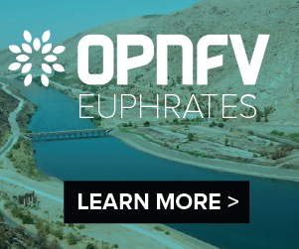
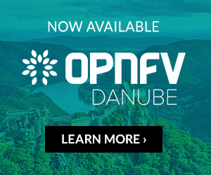
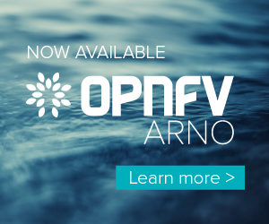
OPNFV Release History
May 1, 2018
Oct 24, 2017
Apr 4, 2017
Sep 26, 2016
Mar 1, 2016
Apr 14, 2019
Jun 4, 2015
Nov 13, 2018

Slide 7
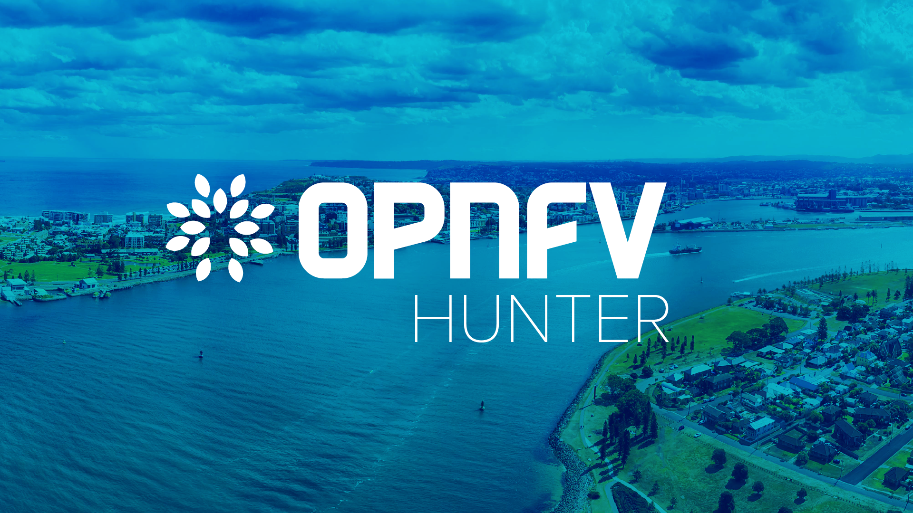

Slide 8
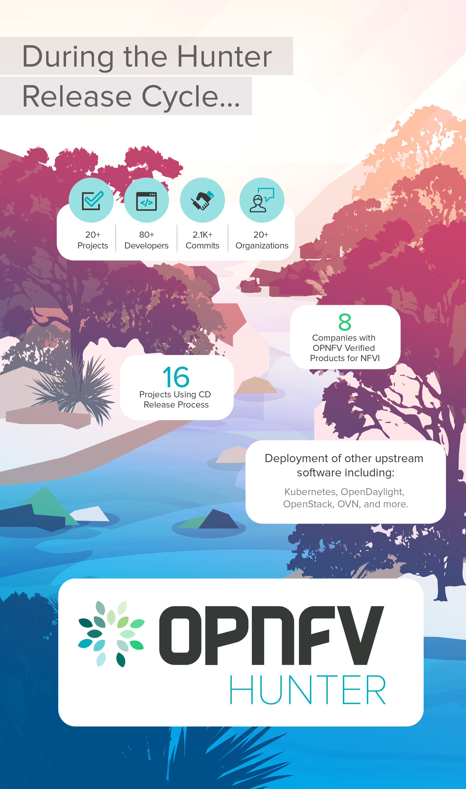
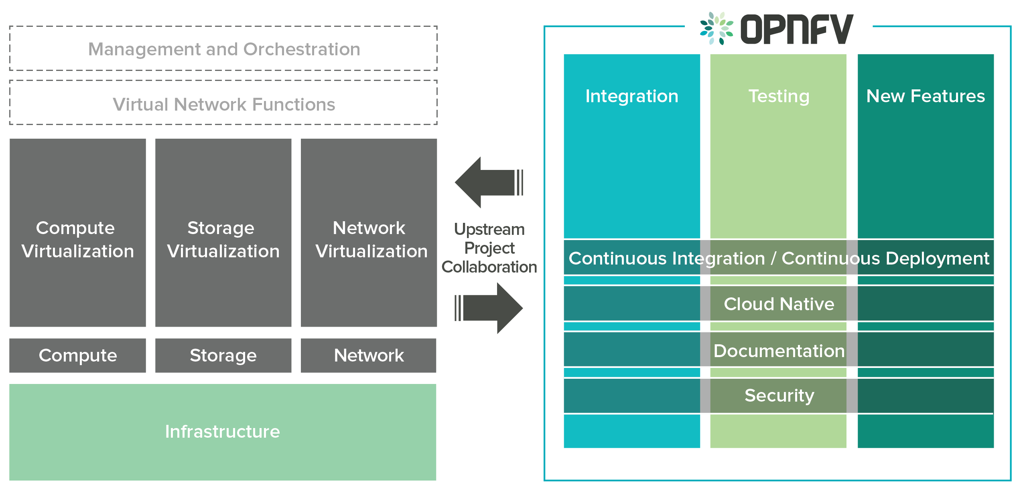
OPNFV Platform Overview

Slide 9
OPNFV Hunter
Integration and Test Projects
The Cross-Community Continuous Integration (XCI) initiative pioneered a Continuous Delivery release process in OPNFV to ensure access to the latest stable code from upstream projects to OPNFV users. Before this process, users would get access to upstream code anywhere from a few weeks to a few months old. The CD process has successfully been embraced by 16 projects in the Hunter release. Additionally, XCI will also be used to create an open source implementation of a common NFV infrastructure specification that is being developed in collaboration with the GSMA and the Common NFVI Telco Task Force. This stack will dramatically reduce the effort CSPs and VNF vendors expend in verifying VNFs against different NFVI platforms. Additionally, it will also help expand the OVP program to verify VNFs with a common NFVI independent of the MANO layer.
OPNFV now also offers a test framework, Xtesting, that assembles dispersed test cases to accelerate CI/CD adoption and can be used to test non-OPNFV components as well. The effort eases building of a CI/CD toolchain for NFV stack components in addition to NFVI/VIM from initial tests to full end-to-end service testing.
The Lab as a Service (LaaS) has now been made easier and more efficient to use with the ability to book an entire POD as opposed to the previous server-by-server reservation.
The Pharos project continues to make progress on specifying an edge POD that will be lighter than the current 6-node POD. Given the constrained real-estate in edge locations, this effort will provide reduction of precious footprint.

Slide 10
OPNFV Hunter
Cross-community Collaboration
C-RAN: A new project relating to performance measurement for Cloud Radio Access Network (C-RAN) VNF was added in Hunter release. This use case further builds towards the vision of a common NFVI that will provide openness, agility, cost reduction, and innovation. A typical C-RAN solution involves complex data plane packet processing functions with stringent latency, jitter, and bandwidth requirements. This project exercises C-RAN VNFs, initially OpenAirInterface, and analyzes the performance characteristics with respect to a common NFVI. The C-RAN project in Hunter offers needed binaries and documentation to successfully build the project environment.
Rocket: Also a new project, Rocket aims at improving virtual Evolved Packet Core (vEPC) VNF performance through hardware acceleration. As performance is directly proportional to NFV economics, this project could help reduce the cost of NFV deployments. The project is working on GPRS Tunneling Protocol (GTP) offload process interfaces to establish optimal hardware-software partitioning. The Rocket project in Hunter contains documentation about the GTP offloading process interface and API definitions.
Other Enhancements: The Hunter release includes container-based undercloud services in the Apex installer and improvements in IPv6 support and service function chaining (SFC). In the journey towards cloud native, the Container4NFV project added support for Kata Containers and container security for the edge. The root cause analysis project, Doctor has been working on non-disruptive infrastructure upgrades and faster alarm generation (27x faster than that of Nova reset server state API). The Doctor team works closely with the OpenStack Felix project. Finally, the Barometer project improved user experience with updates to one-click installer and continues to provide valuable NFVI telemetry to projects such as ONAP.

Slide 11
Create.Compose: A typical workflow
Requirement
Architecture & Gaps
Solution & review internally
Reach & develop upstream
Integrate, test and document
Present demos, collect feedback

Slide 12
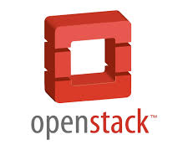
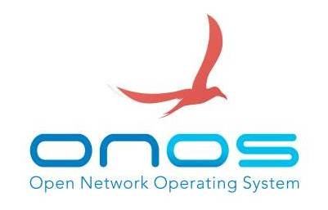
Open Source Building Blocks
PaaS
Application Layer / App Server
Additional PaaS platforms
Cloud Infra & Tooling
Network Data Analytics
Orchestration
VIM Management System
Network Control
Infrastructure
Operating Systems
IO Abstraction & Feature Path
Hardware

Slide 13
Composing the NO-STACK-WORLD
Application Layer / App Server
The “No-Stack-Developer”
Network Data Analytics
OPNFV
Compose
Deploy
Test
Evolve
Iterate
Orchestration
VIM Management System
Network Control
Operating Systems
IO Abstraction & Feature Path
Hardware
Evolve/Integrate/Install/Test

Slide 14
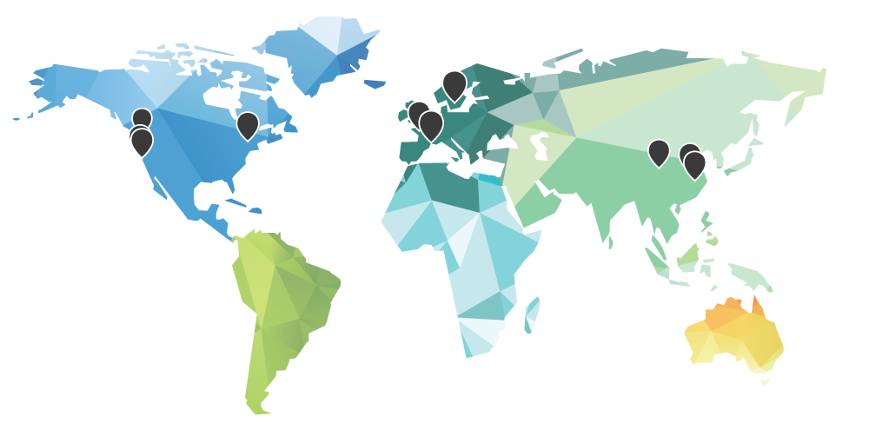
Infrastructure – Distributed Labs (Pharos Project)
Facilitates collaborative testing
Ensures OPNFV applicability across architectures, environments and vendors
Creates more robust, interoperable releases
Pharos Lab-as-a-Service (LaaS) to perform a virtual deployment of OPNFV
XCI Sandbox where developers and testers can create a virtual environment with the latest upstream code
https://www.opnfv.org/community/projects/pharos
https://wiki.opnfv.org/display/pharos/Pharos+Home

Slide 15
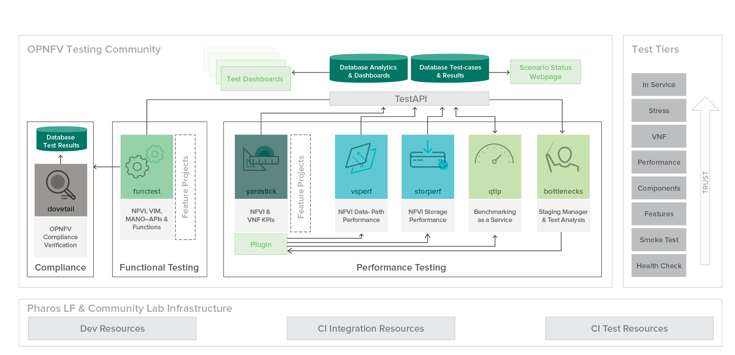
OPNFV Testing Community

Slide 16
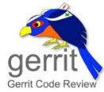
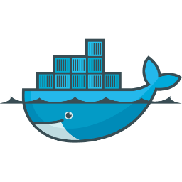
OPNFV CI/CD – Project CI
Google Cloud Storage
Patch
Verified +1/-1
Poll changes
Upload ISO
Clone repo
Build
Build
Build
new
changes?
yes
Build Server
Patchset Verification
Push Image
no
Docker Hub
Notes:
OPNFV CI Homepage: https://wiki.opnfv.org/display/INF/Continuous+Integration
The diagram does not include all the details.

Slide 17
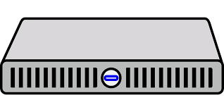
OPNFV CI/CD – Platform CI
Google Cloud Storage
Docker Hub
Docker Hub
Download ISO
Pull Down Functest Image
Pull Down Yardstick Image
Labs connected 24x7 using JNLP
Initiate Run for certain Scenario
Deploy
Functest
Yardstick
Jumphost
Pharos POD (SUT)
Notes:
OPNFV CI Homepage: https://wiki.opnfv.org/display/INF/Continuous+Integration

Slide 18
OPNFV Development Workflow
Project Team
OPNFV Gerrit
OPNFV CI/Test
OPNFV Release
Upstream Gerrit
Upstream CI/Test
Upstream Release
Requirement
Patch
Test
Test
Release
Fast feedback
Document
Downstream
Test
Release
Fast development cycle
Fast feedback, < 1 day
OPNFV specific issues can be tested/detected in time;
Correction in same release
Long development cycle
Downstream will delay to next release
Slow feedback, > 5 months
OPNFV specific issues cannot be tested/detected in time

Slide 19
Cross-Community Continuous Integration (XCI)
System level integration testing and creation of NFV reference platform
Empowers innovation by increasing collaboration between OPNFV and upstream communities
Facilitates development and integration of open source components
Regularly integrates the latest from each supported branch of select upstream projects, slashing the time to implement new features and address bugs from months to days.
http://docs.opnfv.org/en/latest/infrastructure/xci.html

Slide 20
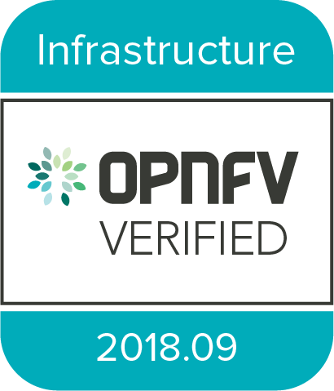
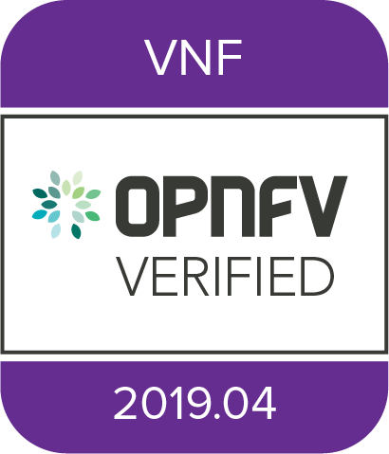
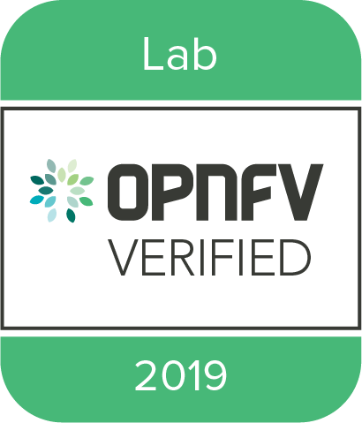
OPNFV Verified Program
The OPNFV Verification Program (OVP) is an open source, community-led compliance and verification program to demonstrate the readiness and availability of commercial NFV products and services, including NFVI and VNFs, using OPNFV and ONAP components.

Slide 21
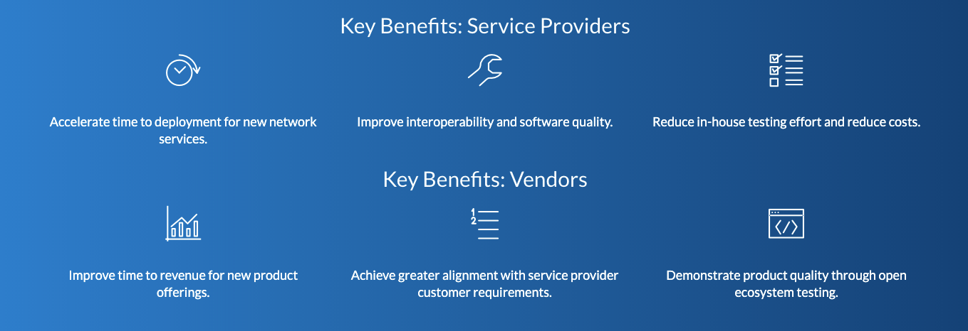
OPNFV Verified Program

Slide 22
OPNFV Verified Program
Get Started Today:
Overview Page: https://www.lfnetworking.org/ovp/
Questions: verified@opnfv.org

Slide 23
Thank You!
Please direct any questions or comments to info@opnfv.org or lfn-info@linuxfoundation.org.

