Slide 2
Virtual Central Office
Looking Ahead to the 5G Edge
Heather Kirksey, VP Ecosystem & Community Linux Foundation Networking

Slide 3
What is VCO?
Cloud Native approach to deploying NFV closest to subscriber
One of the Edge Blueprints as discussed in the community
Based on OpenStack and Kubernetes
Massive Scale => Large Number of sites

Slide 4
VCO Progression
COs Serve Residential, Business & Mobile Customers
Telco CO - Traditional Status
Telco COs - Modernization
Telco COs - Cloud Native
Closed, Rigid and Complex
Variety of Access & Speeds
Wide variety of hardware –
routers, switches, gateways, servers etc
Lack of standard interfaces => lack of programmability
Virtualization
Reduction in CAPEX and OPEX by >30%
Open and Flexible & Standardized
Software Defined
Network
Orchestration
Programmability
Fully Software Defined
Further Reduction in CAPEX and OPEX
Disaggregated and flexible
Massive Scale
Edge Blueprint

Slide 5
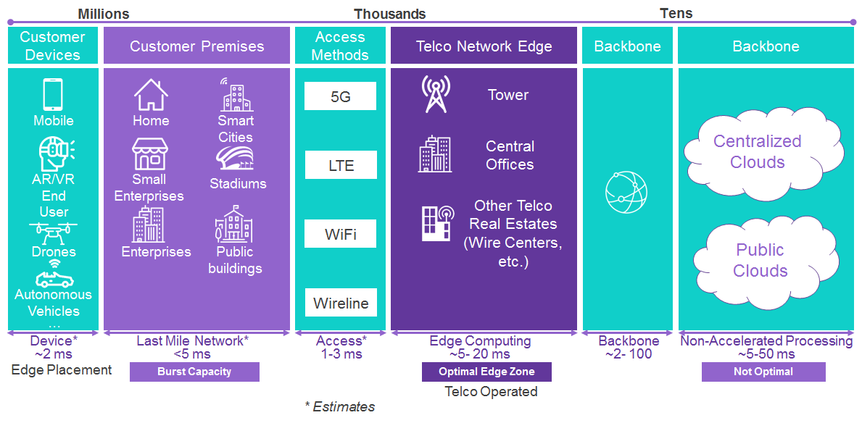
Mobile Edge
SOURCE: AKRAINO WIKI

Slide 6
Telecom Provider Requirements
VCO Demo Checklist
Massive Scale → “Distributed Hyperscale”
Common deployment model for Data Center and CO locations
OpenStack and/or Kubernetes
Flexible and Agile
LTE and 5G Radio with vEPC & NG-Core
Centralized Management and Troubleshooting
Service assurance - Metrics and Events
End-to-End Orchestration
vRAN/CRAN for LTE
vRAN LTE low layer split (RoE)
vRAN LTE high layer split (F1-like)
Low latency service
Network slicing*
Single LTE vEPC
IMS and VoLTE*
Ansible based orchestration
Service assurance & monitoring
Mix of bare metal, VMs, (containers*)
* Goal for future VCO demo

Slide 7
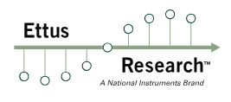
2.0 Hardware and Software Stack
VCO 2.0 Stack
ONAP Orchestrator
NFV Orchestrator, Service Assurance (Met Mon)
VNF Manager
Element Manager
Element Manager
Element Manager
VNF(s)
vBNG
VNF(s)
vRouter
VNF(s)
FW
VNF(s)
FW
SDN Controller
NFVI
Servers/HW
White Box Switch Fabric
‹#›

Slide 8
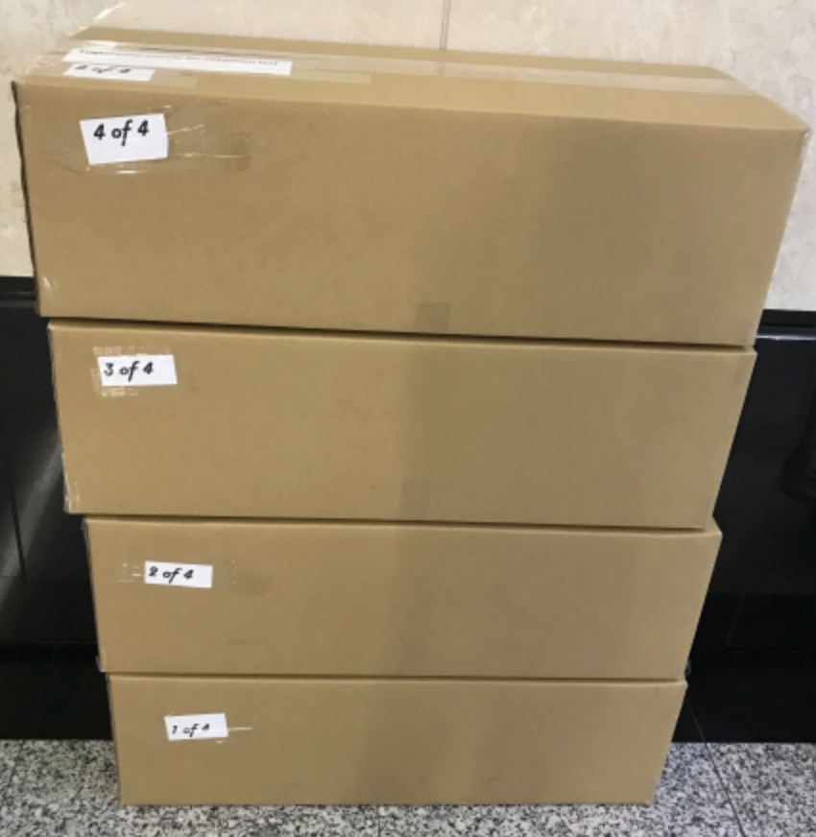
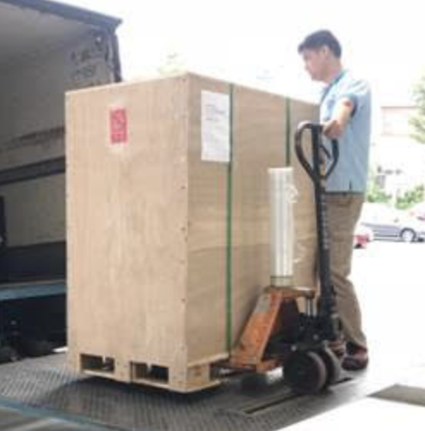
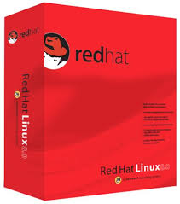
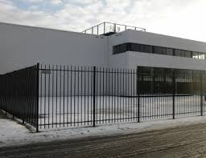
Deploying Open Hardware
August 9
August 20
September 1
TODAY
July 20

Slide 9
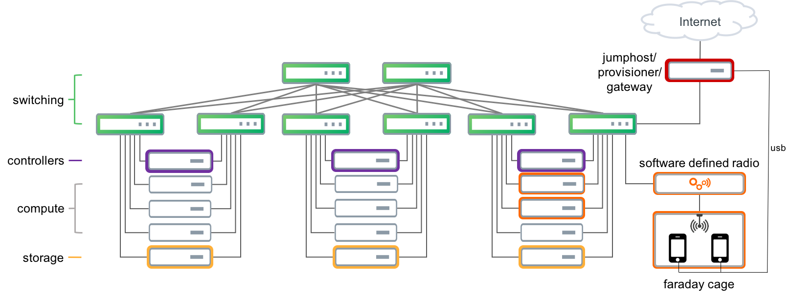
Lab Physical Topology

Slide 10
Virtual Branch Hardware Rack
Wifi Access Point
10Gb Switch
Open RACK
Compute Sled
Open RACK
Compute Sled
Open RACK
Compute Sled
Open RACK
Compute Sled
Empty bay
Empty bay
Empty bay
Empty bay
Shared Power: 230VAC to 12VDC

Slide 11
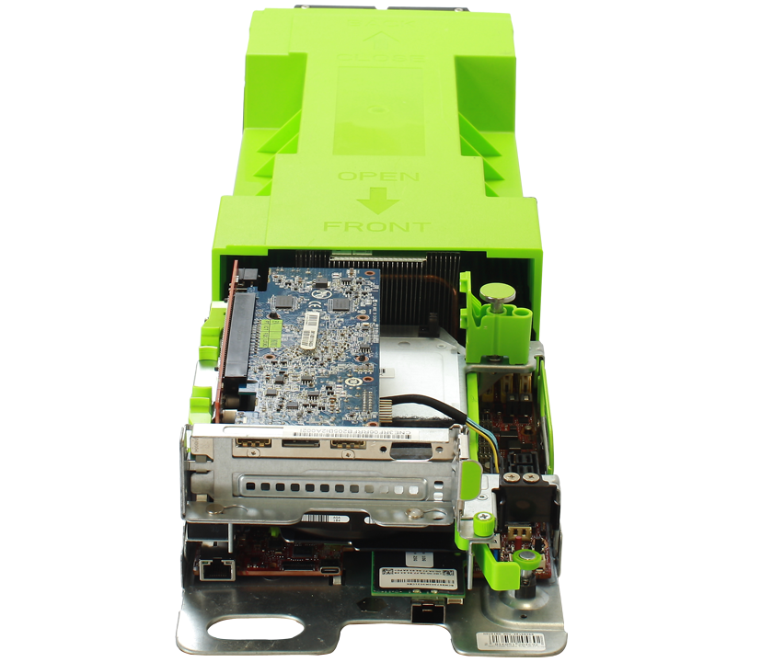
Off the shelf OpenRACK Server Sleds
provided 4 Open RACK servers
CPU: Dual Intel Xeon Gold 6130 (Skylake),16 cores, 22M cache
Memory: 16x16GB, 256GB
Storage: 1 Intel M.2 SSD 1TB for boot drive
NIC Card: 1 Intel OCP X520-DA2 Dual 10Gig network
Notes:
Server sleds are available from many OCP solution providers. These server sleds are compatible with the OpenRACK design. We were fortuneate to have MiTAC’s support in providing the sleds used in today’s demo.

Slide 12
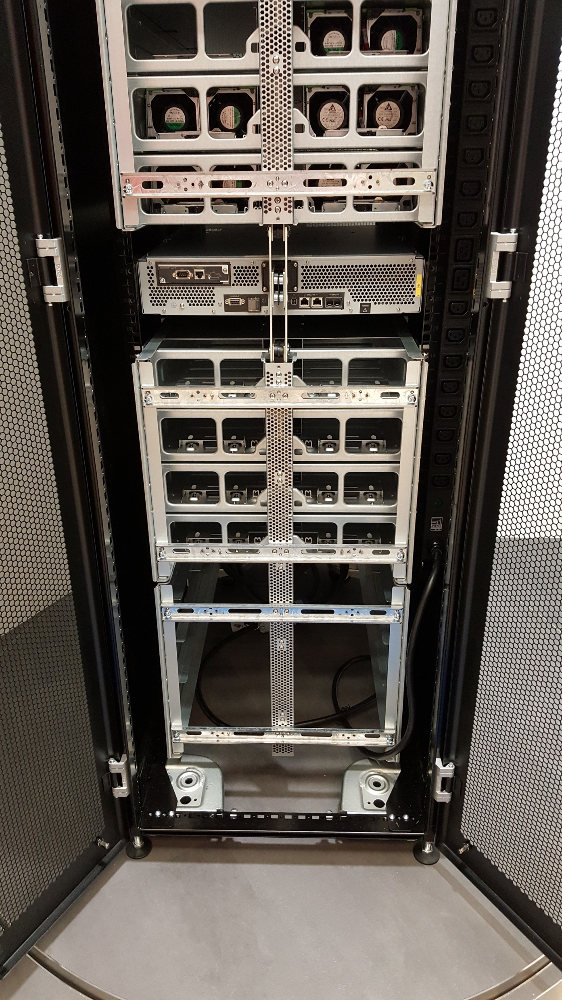
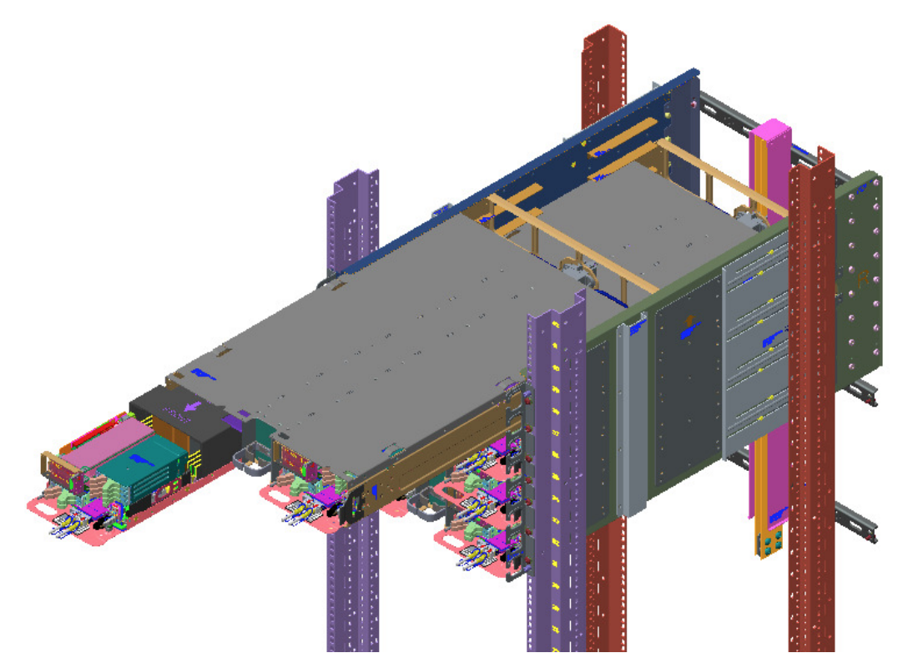
ESA Chassis and Network card
provided ESA Chassis
Uses OCP Open Rack sleds into an EIA-310 19’’ rack.
Ideal for Telecom and Enterprise with legacy requirements
Includes the rail kit, shelves and 12V DC bus bar.
Power shelf with power supplies to convert 230V AC to 12V DC
Edgecore AS-6712 (32 X 40Gig) provided by
ESA with Shelf (Front Side)
Notes:
ESA rack allows adoption of scalable, open, efficient servers to be installed into legacy 19” racks. Good transitional product option for brownfield locations.

Slide 13
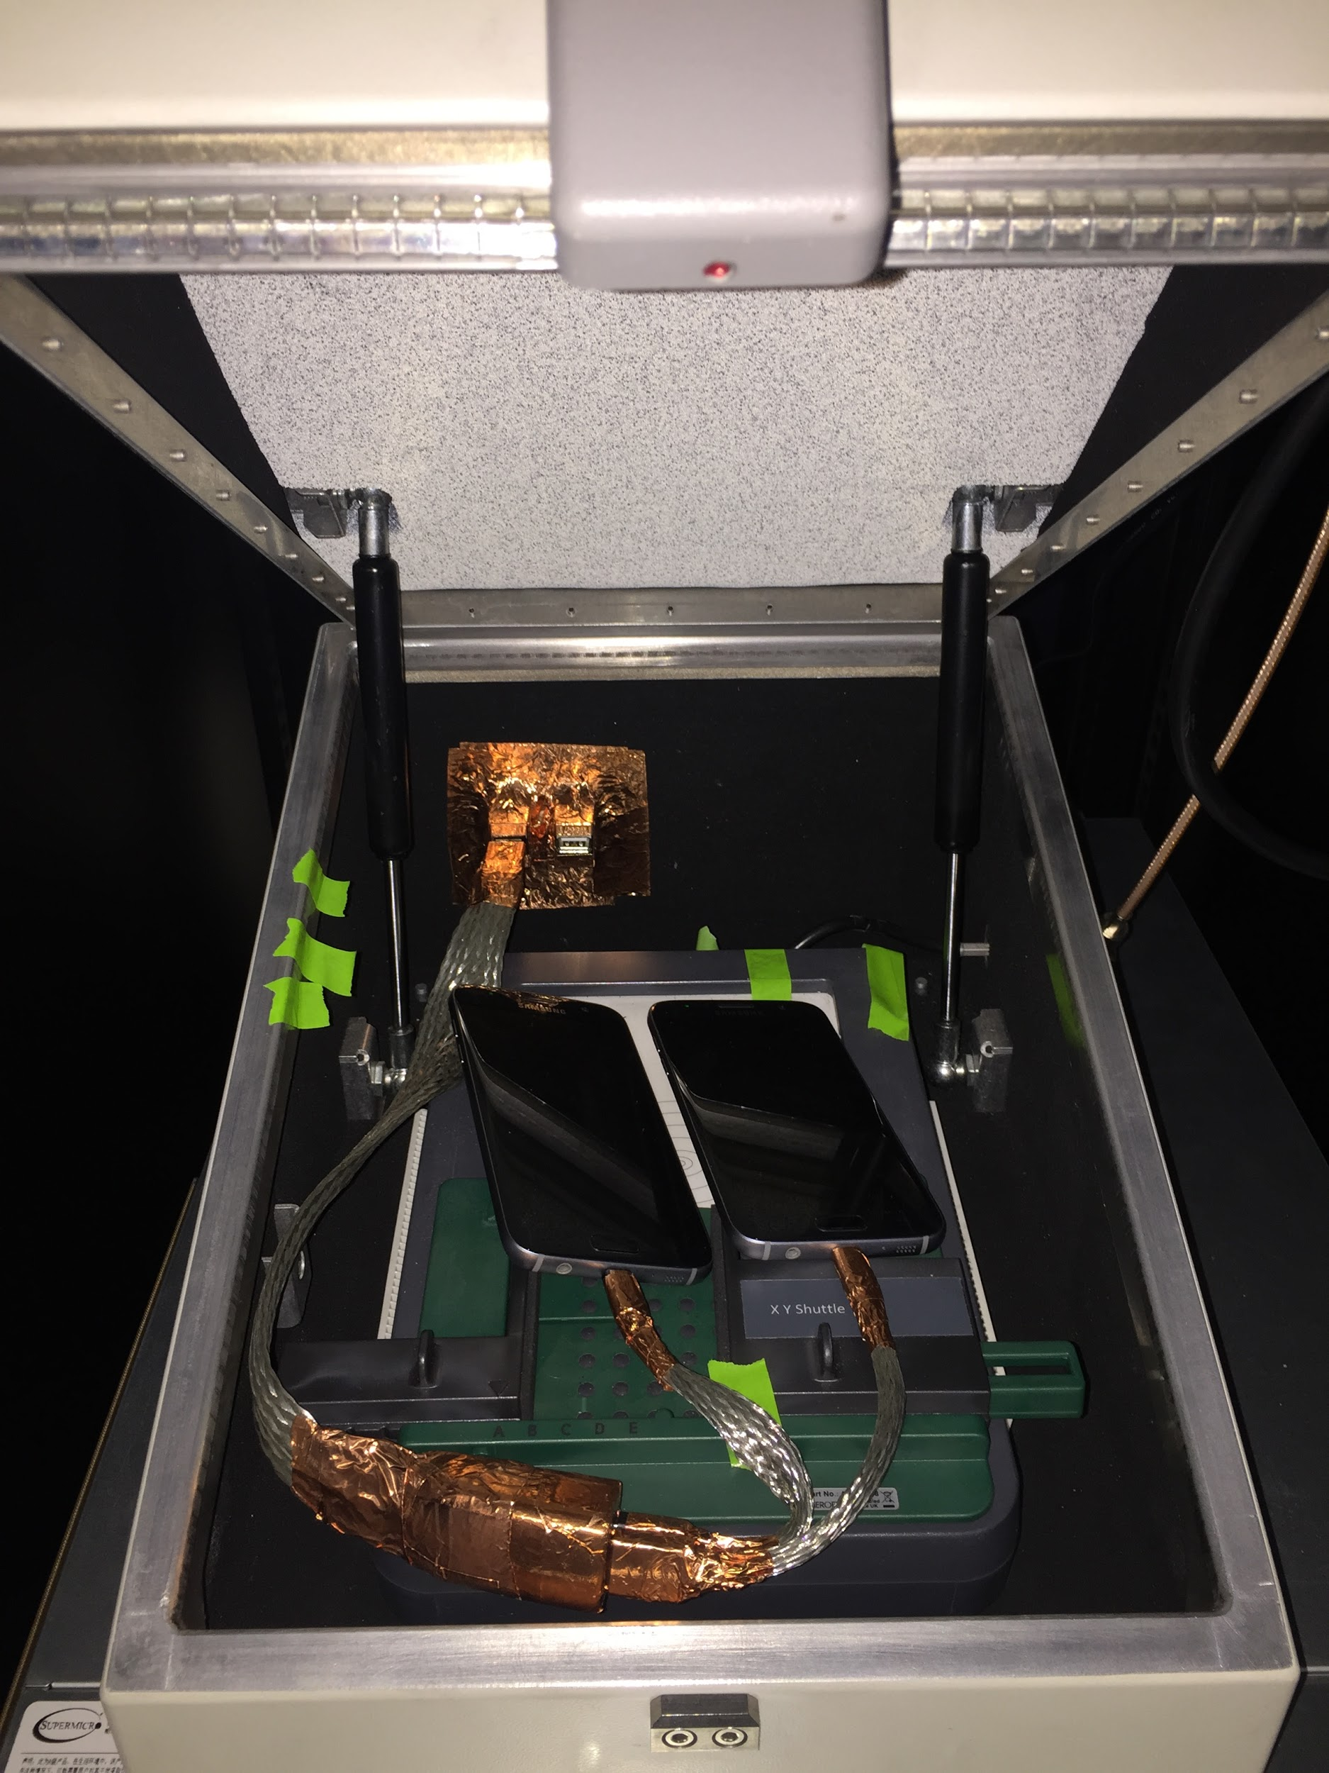
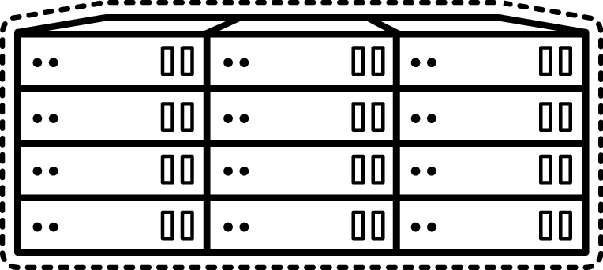
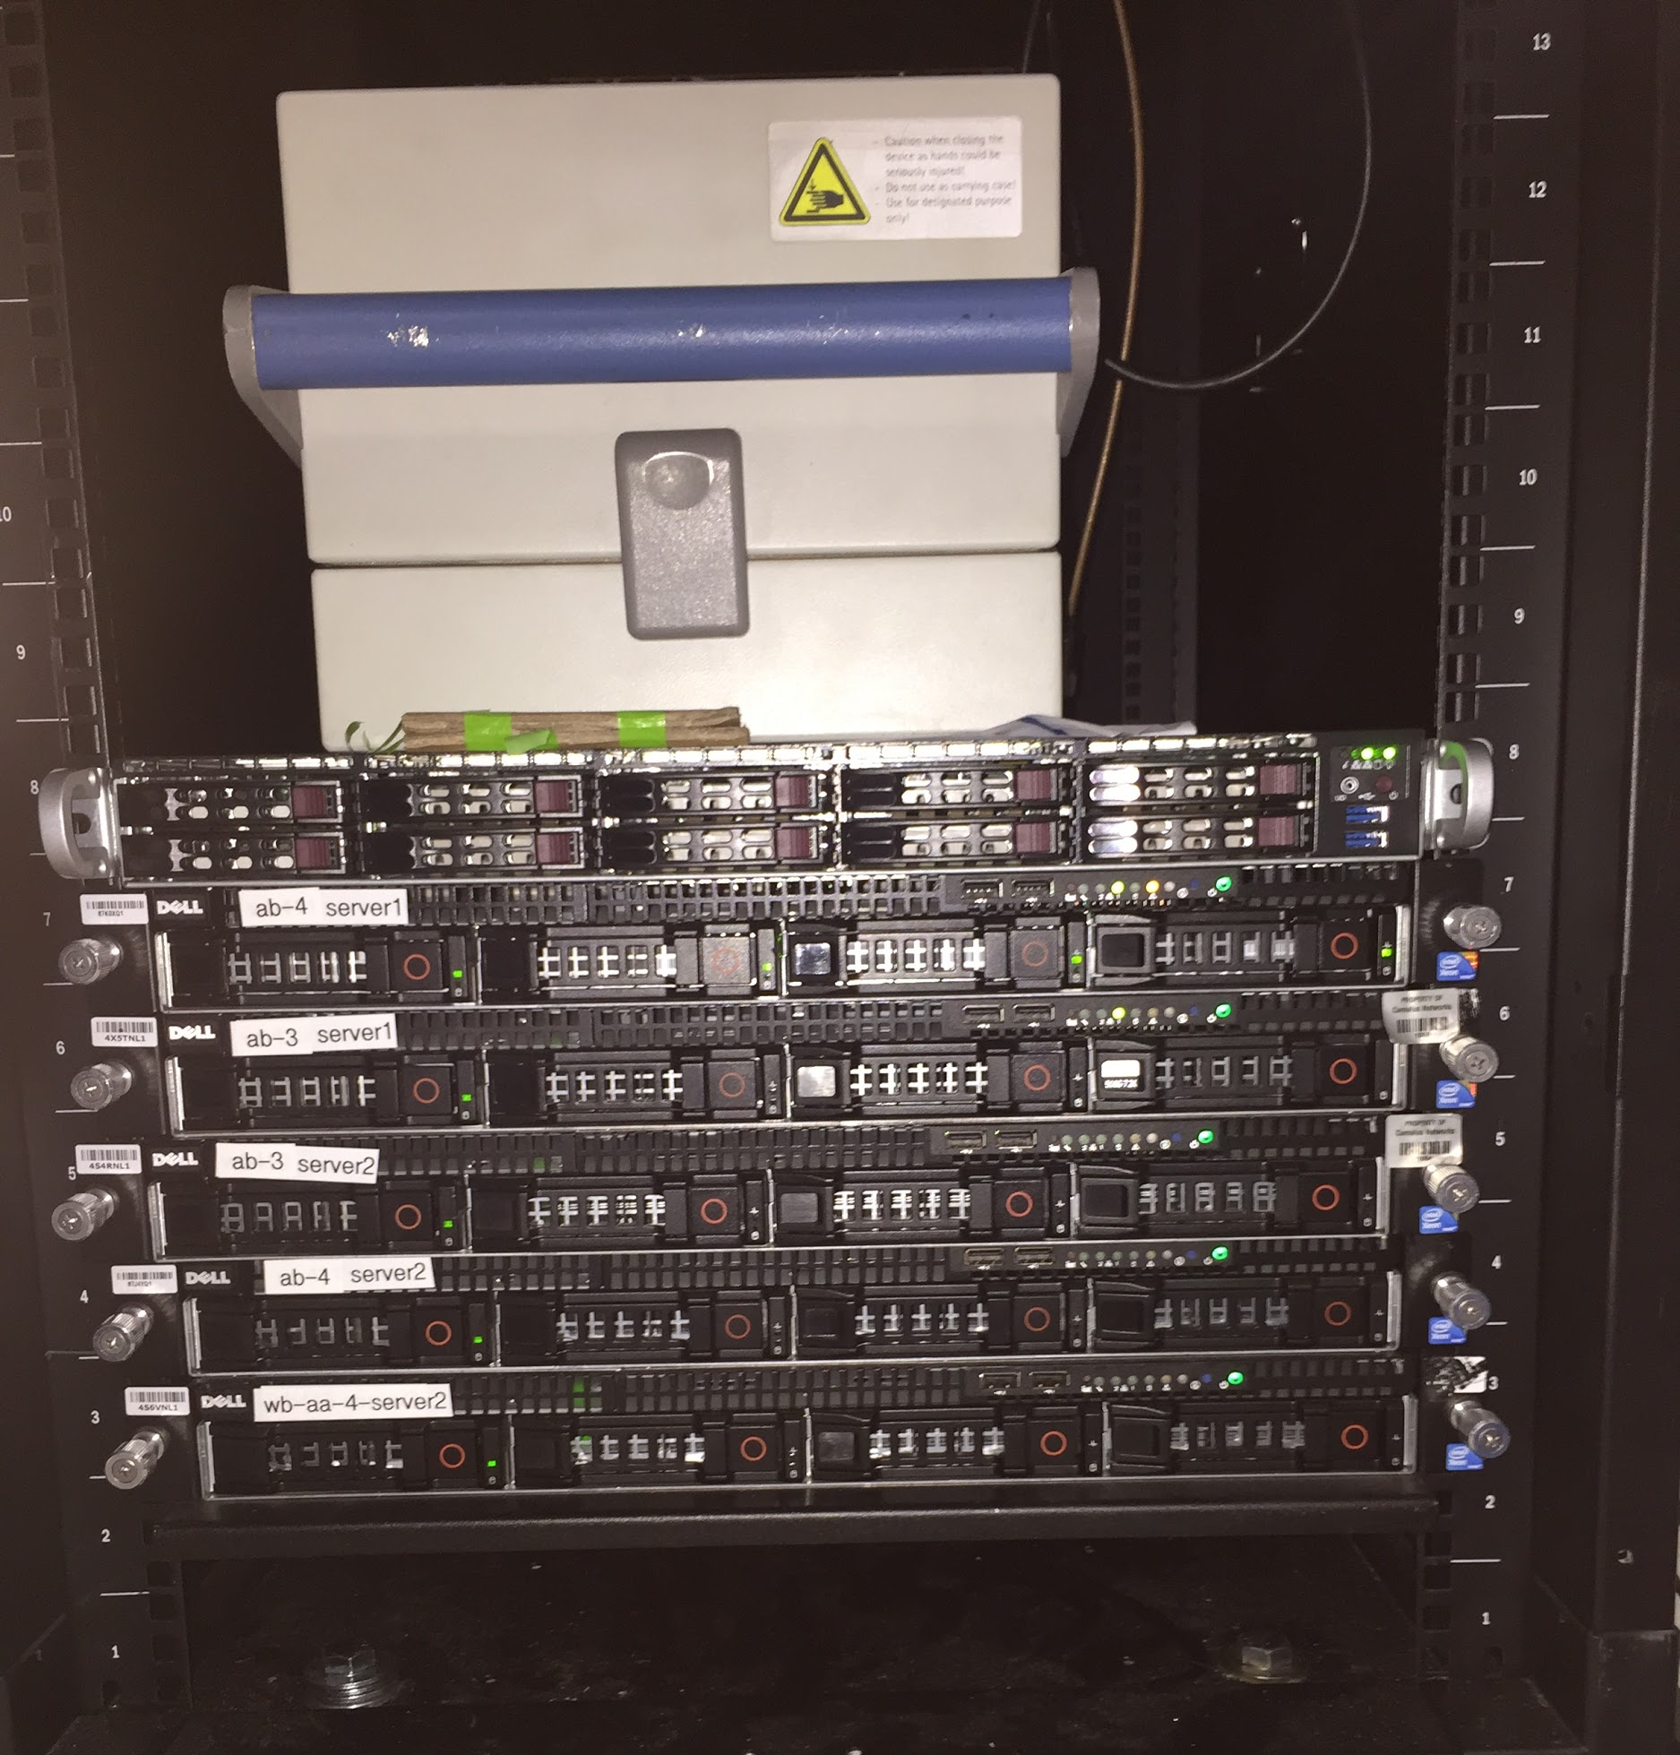
Demo Topology
OpenStack
RU
DU
SDR
CU
SGW
MME
HSS
Baremetal Nodes
Managed by OpenStack
SD
Jumphost
PGW
PGW
GiLAN
VPN
Internet
Internet
Amsterdam Stage

Slide 14
VCO Demo

Slide 15
Learn More and Get Involved!
Learn more in the LF Networking Booth
Engineering Workshop Tuesday 13:25, G105
Join VCO Demo Mailing List: opnfv-vco@lists.opnfv.org
Join the OPNFV CRAN, Edge, Rocket projects
Get involved in OCP Networking and Server Projects. Please visit https://www.opencompute.org/projects

Slide 16
Ecosystem Partners

Slide 17
A Cross-Community Open Source
Collaboration
Notes:
Learn more in the LF Networking Booth and Circle B booth
Join VCO Demo Mailing List: opnfv-vco@lists.opnfv.org and
Join the OPNFV CRAN, Edge, Rocket projects
Software folks go in one location and the HW folks go to the another - Rajeev to refine

